Slide 1
Queues
FIFO Data Storage

Slide 2
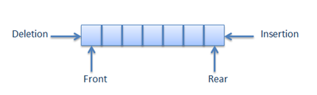
What makes a Queue?
  Like a Stack, a Queue is a linear end-point sequence
    Data is stored in linear sequence
    Data can only be accessed at one point; the front/start
      This means data cannot be searched or amended within the sequence
    Data can only be added at one point; the rear/end
  A Queue works as FIFO - First In, First Out
    Opposite to stacks
    First element to be added is the only thing you can currently access

Slide 3
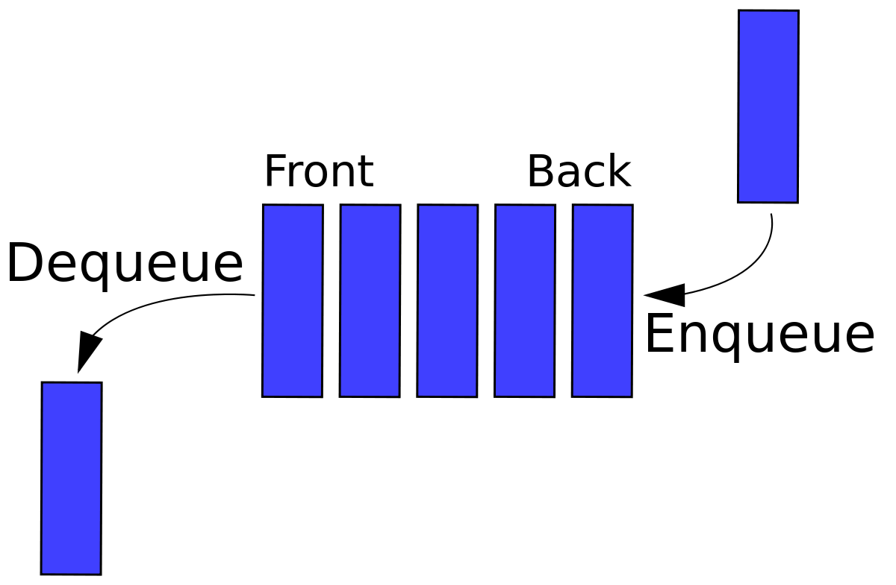
Fundamental Operations for a Queue
  Queue is also a greatly reduced/restricted form of list
  Queues can:
    Add an element to end of the queue (enqueue)
    Remove the top element from the queue (dequeue)
    Check the element on top of the queue without removing it (peek)
    Count elements in the queue
    Check if the queue is empty
    Check if the queue is full (Bounded variant only)

Slide 4
Queue ADT: A More Formal Definition
  enqueue(e) Insert element e at the end of the queue
    Input: Element to be added
    Output: None
  dequeue() Remove element from front of the queue and return it. If the queue
  is empty, an error should occur
    Input: None
    Output: Element
  peek() Retrieve element from front of queue and return it. This should NOT
  remove the element from the queue. If the queue is empty, an error
  should occur
    Input: None
    Output: Element

Slide 5
Queue ADT Continued
  count() Return the number of elements in the queue
    Input: None
    Output: Integer
  isEmpty() Return a boolean indicating if the queue is empty
    Input: None
    Output: True/False
  isFull() Return a boolean indicating if the queue is full
    Input: None
    Output: True/False
Note: This is only NEEDED in a bounded queue, i.e. when implementing queues with a limit on their size

Slide 6
Queue ADT: Some Alternative Options
  Queues are not as restricted as Stacks
    The methods listed in the ADT are more of a starting point.
    Even method names aren’t fixed!
  Java even offers two versions/approaches to operations:
    Safe: No chance of an exception.
    Alerting: Exceptions may happen – developed from the idea of failing fast

Slide 7
The Fail Fast Attitude
  Fail fast: if something goes wrong, fail immediately, and fail visibly
    Throw an exception, make noise (fail visibly)
    Do it as soon as you can (fail immediately)
  This is the same approach we’ve been taking to handling inappropriate parameters and index values outside array bounds
    Check for issues with the information as soon as the method begins (failing immediately)
    Throw an appropriate exception to inform the calling code what happened (failing visibly)
  If you fail obviously, it is much easier to detect
    Returning null where something was expected means the calling code will have to check it’s not null before trusting it exists
    Throwing an exception is a very obvious sign that nothing was found

Slide 8
Safe Vs Alerting
  Alerting methods in our ADT:
    add() / enqueue() – Can throw an exception in a bounded queue if the queue is full
    remove() / dequeue() – Can throw an exception if the queue is empty
    peek()* - Can throw an exception if the queue is empty
  Safe alternatives:
    offer() – TRY to add it, and if the queue is full, return false to indicate the addition was unsuccessful
    poll() – TRY to remove the first element, and if the queue is empty, return null.
Java’s alerting version is element(),
peek() is safe!
Notes:
*Java’s alerting version is called element(), while its safe version is called peek()

Slide 9
Implementing the
Queue ADT
Arrays V.s. Linked Lists

Slide 10
Approaches to Queue Implementation
  Just like Stacks, there are two main approaches to coding an implementation of a Queue ADT
    Array-based
    Pointer/Link-based <- we will focus on this approach!
  In both cases, you must track the start and end of the queue data
  Array-based:
    Track the position of the last item added to the queue (the end position)
    Track the position of the first item added to the queue (the start position)
  Link-based:
    Track the first node in the list (the start position)
    Track the last node in the list (the end position)
      Always add to the end of the list, i.e. connect newNode to the tail/last node

Slide 11
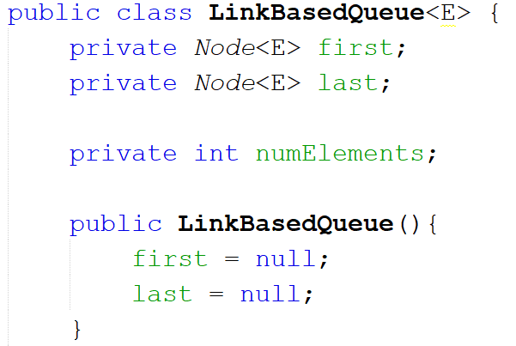
Link-based Implementation
  Required:
    A Node to store the first element in the queue
    A Node to store the last element in the queue
    A count of the number of elements in the queue

Slide 12
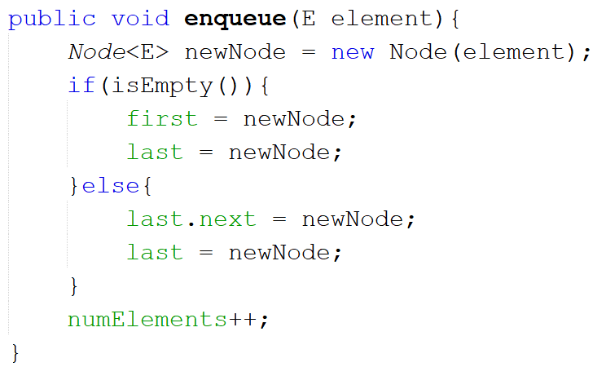
Adding to a Link-Based Queue
  When enqueueing:
    Create Node to store new element
    Check queue is not empty
      If it is, add new node as both first and last elements in queue
      If it’s not:
        Point next pointer within current last element to the new node
        Set last element to point to new node
        Increase element count by one

Slide 13
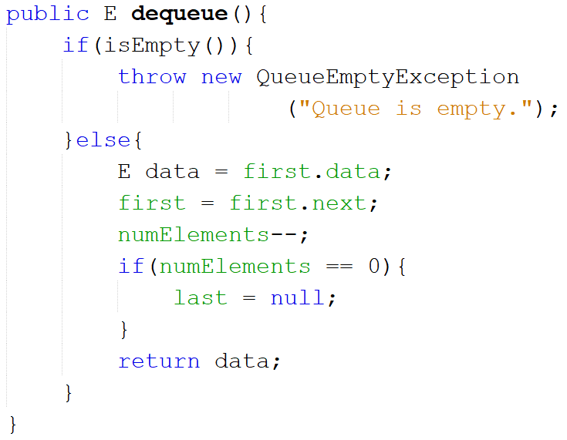
Removing From a Link-Based Queue
  When dequeueing:
    Check there is an element in the queue
      If there isn’t, throw a QueueEmptyException NoSuchElementException*
      If there is:
        Copy data in first element to temp variable
        Set first pointer to point to next element in the queue
        Decrease element count by one
        Check if there is anything left in the queue
          If it’s empty, set last to null
        Return temp variable
NoSuchElementException
Notes:
* QueueEmptyException is a custom exception class. The NoSuchElementException is from Java’s exceptions library and is equally useful, plus doesn’t require writing an extra class)

Slide 14
Priority Queues
  Priority queues are queues with a twist - all elements are added in order of priority
    Works based on Comparable and Comparator interfaces
  Enqueueing an element should:
    Check if the first element has lower priority
      If so, insert in front of first element
    If not, check if last element has higher priority
      If so, insert after last element
    If not, start at start of queue and:
      Check if the element in the queue has higher priority than element to be added
        If it does, move the element after this
        Continue until you find an element with a lower priority
          Insert between that one and its next node
How can we tell which has higher/lower priority??

